Slide 1
DIP 2013 – Smart Fast Forward

Slide 2
Overview

Slide 3
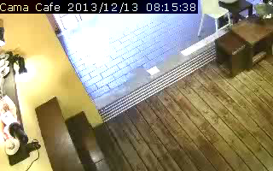
Smart Fast Forward Concept

Slide 4
Processing Stage Overview
Multi-Threaded!
OpenCV
Decoder
Background
Subtraction
Object Detection
Video
Object Regions & Labels
Object Labeling
(Tracking)
Frame weight
estimation
Kalman
Filter
Playback Speed

Slide 5
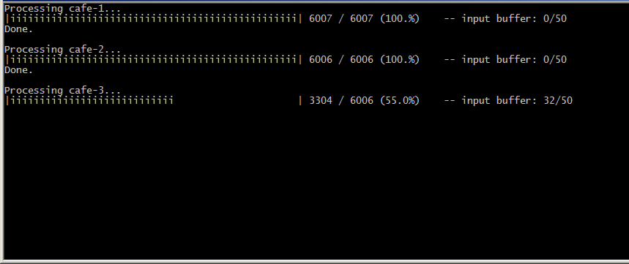
Processing Stage Output

Slide 6
Background Subtraction

Slide 7
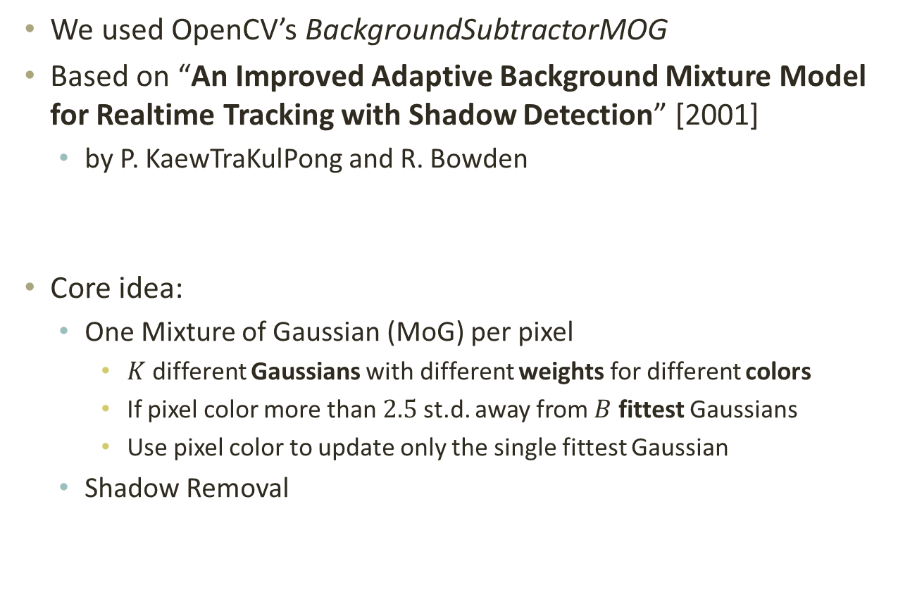
Background Subtraction MoG
We used OpenCV’s BackgroundSubtractorMOG
Based on “An Improved Adaptive Background Mixture Model for Realtime Tracking with Shadow Detection” [2001]
by P. KaewTraKulPong and R. Bowden
Core idea:
One Mixture of Gaussian (MoG) per pixel
$K$ different Gaussians with different weights for different colors
If pixel color more than $2.5$ st.d. away from $B$ fittest Gaussians
Use pixel color to update only the single fittest Gaussian
Shadow Removal

Slide 8
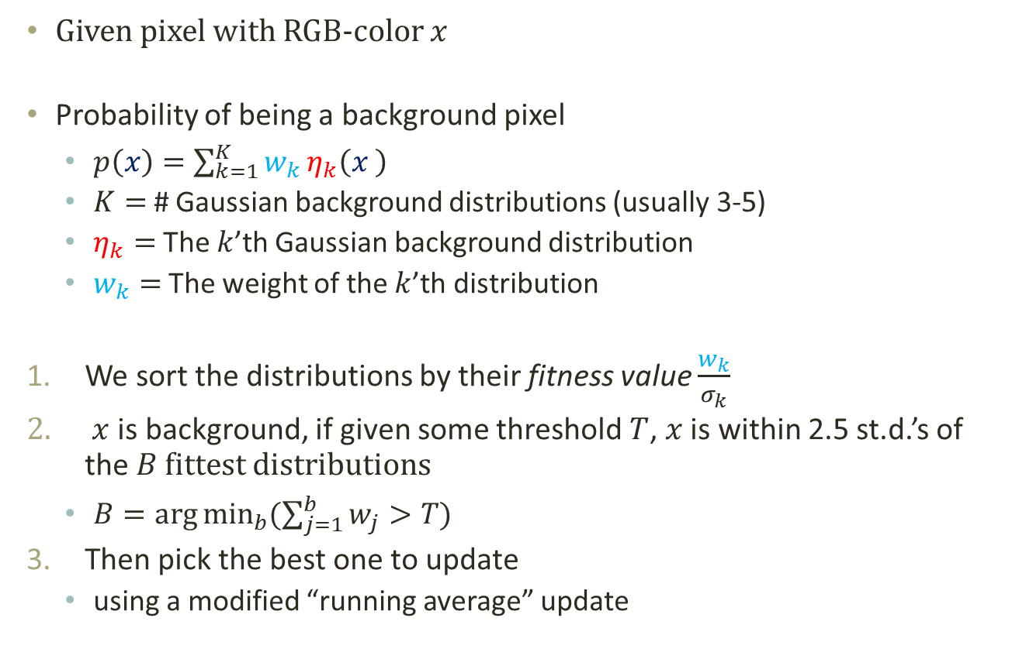
Background Subtraction MoG
Given pixel with RGB-color $x$
Probability of being a background pixel
$p\left(x\right)=\sum_{k=1}^{K}{w_{k}}η_{k}\left(x \right)$
$K=$ # Gaussian background distributions (usually 3-5)
$η_{k}=$ The $k$’th Gaussian background distribution
$w_{k}=$ The weight of the $k$’th distribution
We sort the distributions by their fitness value $\frac{w_{k}}{σ_{k}}$
$x$ is background, if given some threshold $T$, $x$ is within 2.5 st.d.’s of the $B$ fittest distributions
$B=\arg{\min_{b}{(\sum_{j=1}^{b}{w_{j}}>T)}}$
Then pick the best one to update
using a modified “running average” update

Slide 9
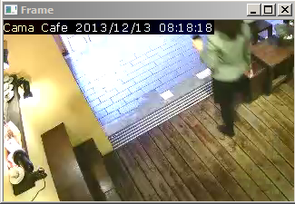
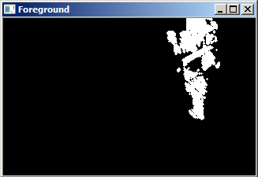
Background Subtraction Results

Slide 10
Object detection

Slide 11
Object Detection

Slide 12
Agglomerative Clustering
Clustering to identify individual.
But centroid-based clustering are prone to stretched clusters or varying cluster size.
Agglomerative (Hierarchical) Clustering
One of the efficient implementations is similar to finding a planar Minimum-Spanning Tree.

Slide 13
Object Tracking

Slide 14
Object Tracking
Inter-frame relationship (which object becomes which in the next frame) are determined by a weighted matching.
Here, the term “matching” is general and it is possible for multiple object to match into one (occlusion) or one object to split into multiple.
Matching cost between two clusters (of consecutive frame) is a value determined by their difference in feature (expected position, size) and
Could be solved as a minimum-cost matching problem, where efficient algorithms (e.g. Hungarian Method) exist.

Slide 15
Playback Speed estimation

Slide 16
Playback Speed Estimation Frame Weights
TODO

Slide 17
Playback Speed Estimation Noise-Aware Smoothing

Slide 18
Results
TODO

